Slide 1

Project SEARCH
Grady Memorial Hospital
Program overview, student population and eligibility factors, partners, common workplace barriers and building a lasting relationship between school and business.

Slide 2
Introductions/Program Site video
Maddy Shumaker
Project SEARCH Instructor-Grady Memorial Hospital
Delaware Arear Career Center
https://youtu.be/ne-VShnGhBM

Slide 3
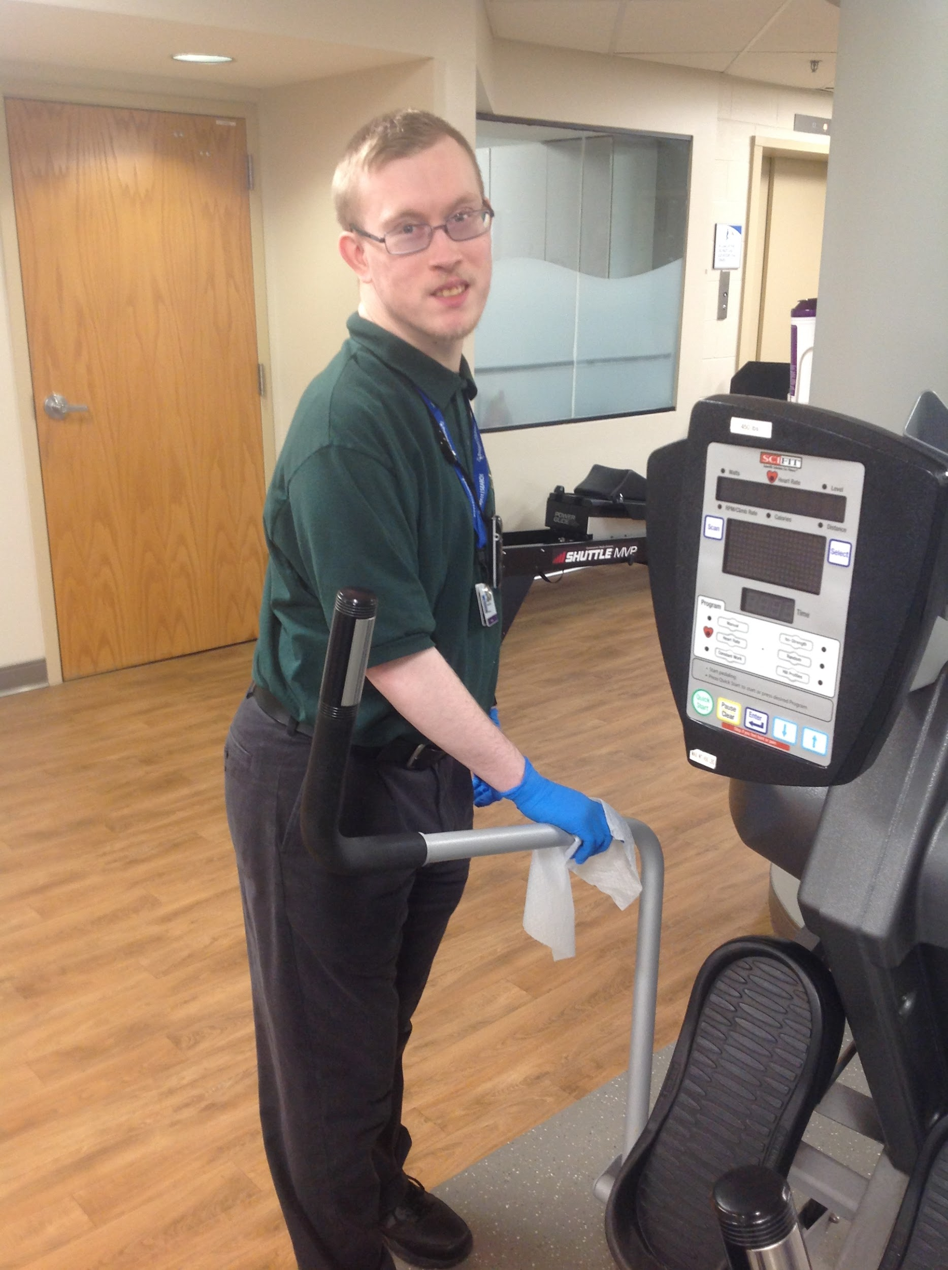
Project SEARCH Mission
The Mission of Project SEARCH is to provide vocational training and real-life work experience in order to prepare interns for community employment.
Internship rotation: Rehabilitation Services

Slide 4
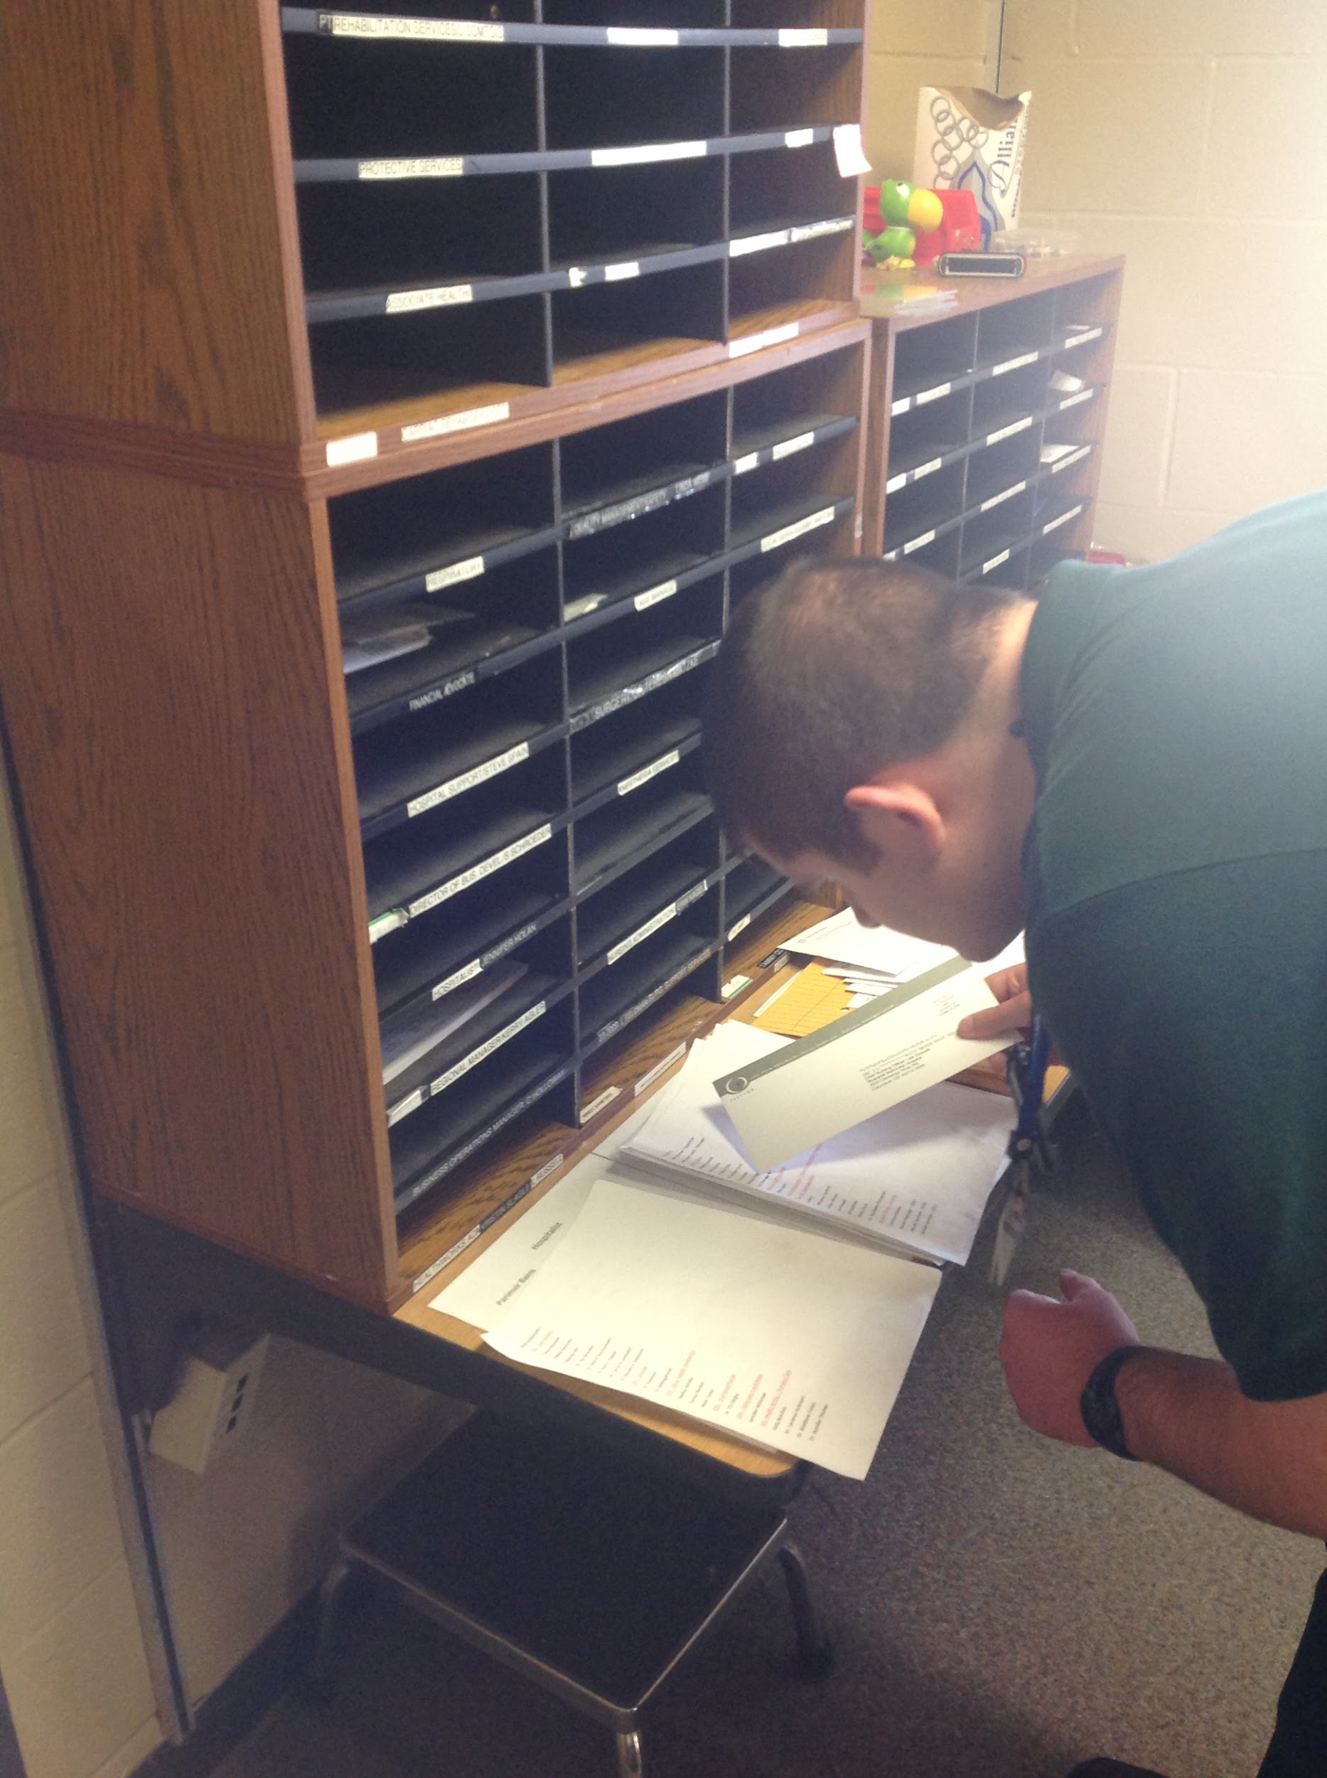
Program Overview
Project SEARCH is a vocational training program for young adults with disabilities transitioning from high school into the workforce
Project SEARCH offers students classroom time to learn employability skills to put into practice in an actual workplace environment
Students intern are assigned three, 10 week internship rotations within the host business
Overall goal of Project SEARCH is employment
Internship rotation: Mailroom-sorting

Slide 5
Program eligibility
Program is for high school students with disabilities currently receiving IEP services
Student must have completed all state testing and home district graduation requirements
  Deferred graduation
Students must be at least 18 years of age and no older than 22 (age of majority)
Students must be eligible and linked to Bureau of Vocational Rehabilitation services (under OOD-Opportunities for Ohioans with Disabilities)
County Board of Developmental Disabilities eligibility is not required but recommended
Student (and family) must agree that this is the student’s last year of student services, and will accept diploma at the end of the school year
Ability to become primarily independent over time in general employability skills and taught job tasks
Ability to pass a drug screen, background check and immunizations are up to date
  OhioHealth health assessment
Desire and plan to work competitively in the community at the conclusion of the Project SEARCH program

Slide 6
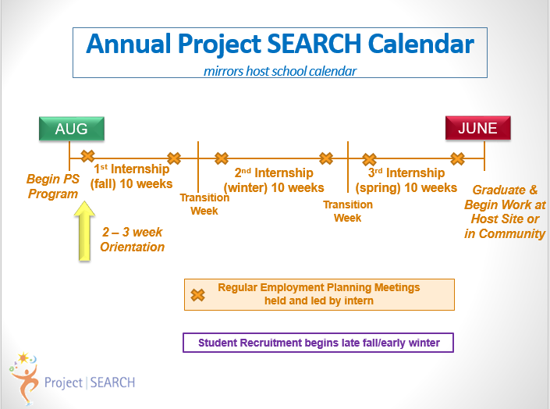

Slide 7
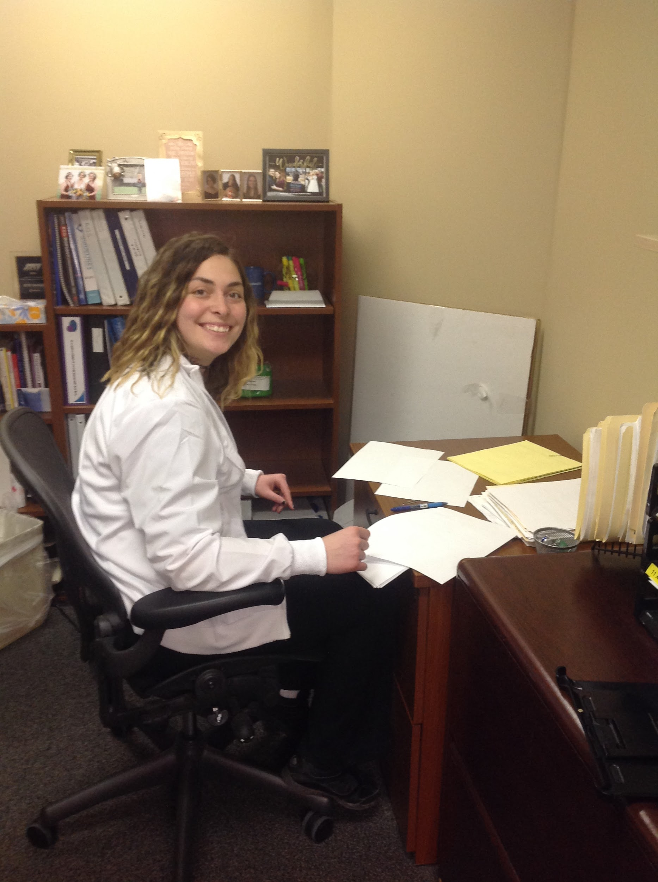
Typical daily schedule
8:00-9:00: Classroom instruction on employability skills
9:00-11:30: Internship rotations
  Currently have 20 internship sites
11:30-12:00: Lunch
12:00-1:00: Internship rotations
1:00-2:00: Classroom instruction on employability skills
Internship rotation: Outpatient Care Center/Endoscopy

Slide 8
Host business role and responsibilities
DACC Project SEARCH hospital business: OhioHealth Grady Memorial Hospital
Role: Provide authentic workplace setting and internship opportunities
Responsibilities:
  Business liaison-member of Grady leadership
    Provides internal support with department communications, developing and maintaining internship rotations as needed
  Associate Health and Wellness workplace accommodations case manager
    Attends intern team/employment planning meetings, arranges job shadows, other OhioHealth facility tours, aides in job search process within OhioHealth, support job trials, sits on program advisory board
  Program utilizes conference rooms for employment planning meetings and other related program meetings and events

Slide 9
Program partnerships and roles
Delaware Area Career Center
  Instructor: Facilitator of program operations and communications, classroom instruction
The Alpha Group
  Job coaching: 4:1 intern:coach ratio, assists interns 1:1 initially to learn internship, staff and tasks until primarily independently and after internship progress monitoring and OOD reporting
  Job development: assisting in job search process and new hire
Opportunities for Ohioans with Disabilities
  BVR case manager: funds for job coaching and development services and transition planning for employment

Slide 10





Program partnerships and roles
Delaware and Franklin County Board of Developmental Disabilities
  Transition Administrator: member or intern team employment planning meetings, provides longer-term employment and independent living planning and supports services
Delaware City, Big Walnut Local, Worthington City, Westerville City, Olentangy Local, and Buckeye Valley Local
  Home schools: Provide transportation and related IEP services

Slide 11
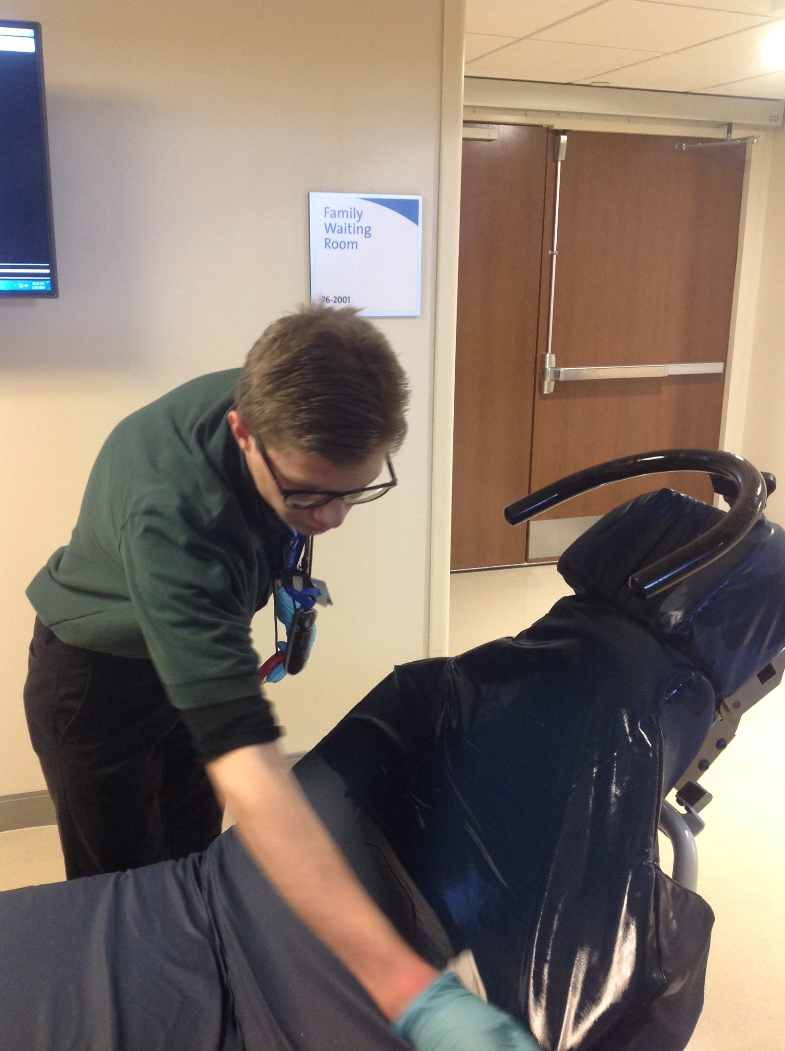
Common barriers
Disability awareness
Department disclosure of intern behavior
Lack of ability to perform full scope of certain internship tasks
Understanding of program mission and goal
Understanding of individual department rules and regulations
  Position standards
Internship rotation: Surgery Department

Slide 12
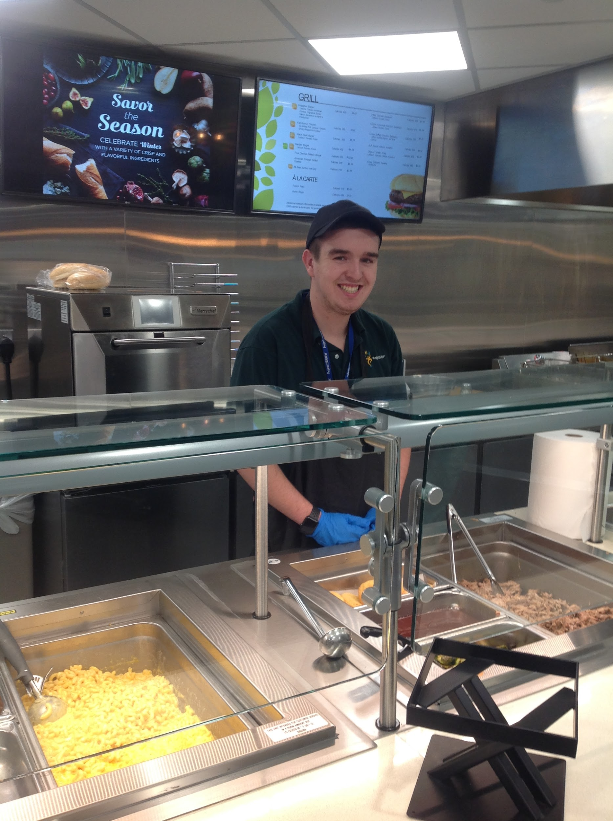
Tips for successful employer relationships
Frequent and open line of communication
Visibility of SEARCH staff
  Check-ins with staff by job coaches
Educating staff on program mission and goal
  Strategies to best support interns
Working along department staff to resolve interns performance concerns
Monthly meetings with business liaison
Monthly intern input for department staff
Department shadowing/summer meetings
Closely aligning program standards and policies to host business
Internship rotation: Nutritional Services

Slide 13
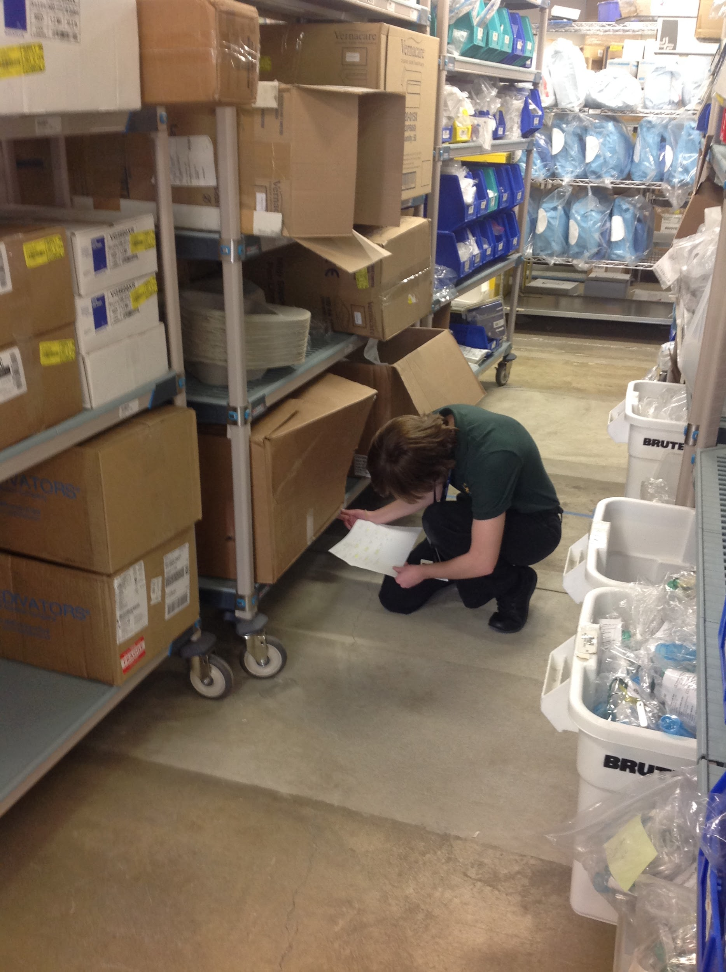
Employment success
Linkage to employment supports (OOD/BVR) and long-term services (CBDD)
  Job Development and coaching
Employment planning meetings
  Participation by all program partners
Intern involvement
  Practiced employment expectations and skills
  Developing independence and self-advocacy skills
  Leading employment discussions-active role
Family involvement
  Key insight into student history and background: interest, strengths and needs
  Understanding of transition from school to work
    Workplace accommodations
    Meeting standards
Matching intern skill set, interest, strengths and experience to employment
  Collaborative team input and effort
Internship rotation: Supply Chain

Slide 14
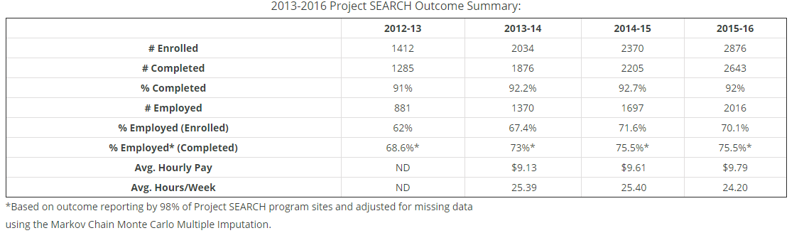
Program Statistics
Grady Program 2014-2018-
Year one: 7/8 employed-2 host site, 5 community employment
Year two: 6/7 employed- 3 host site, 3 host site
Year three: 7/8 employed-all community employment
Year four: 4/8 currently placed-1 host site, 2 community employment
- Of remaining 4-3 in JD and 1 will continue to work at current job with more hours and responsibility

Slide 15
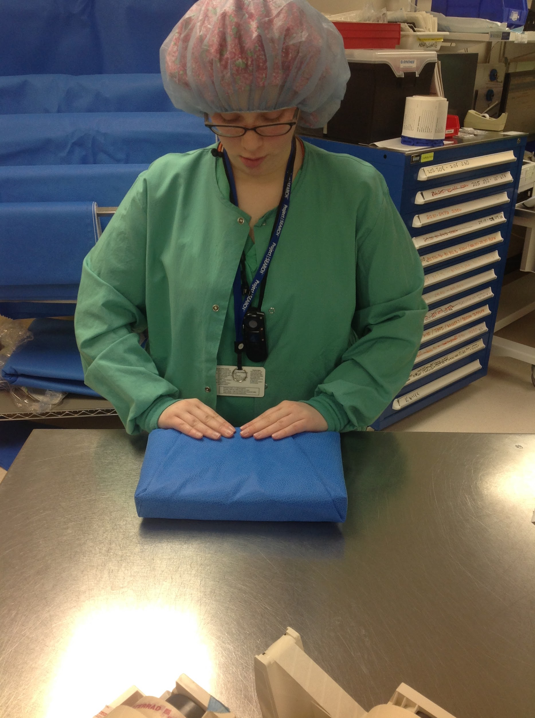
Resources:
Grady Program resource website
Main Project SEARCH website
National Project SEARCH Curriculum
Internship rotation: Sterile Processing

Slide 16
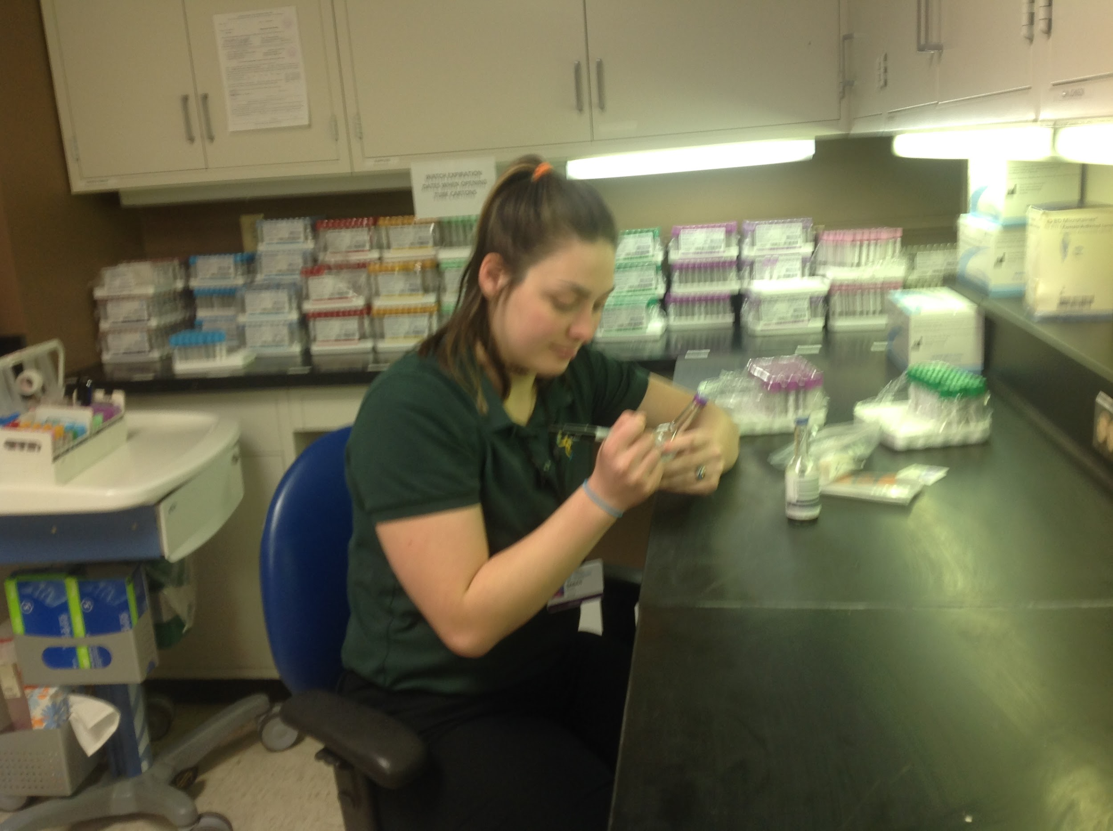
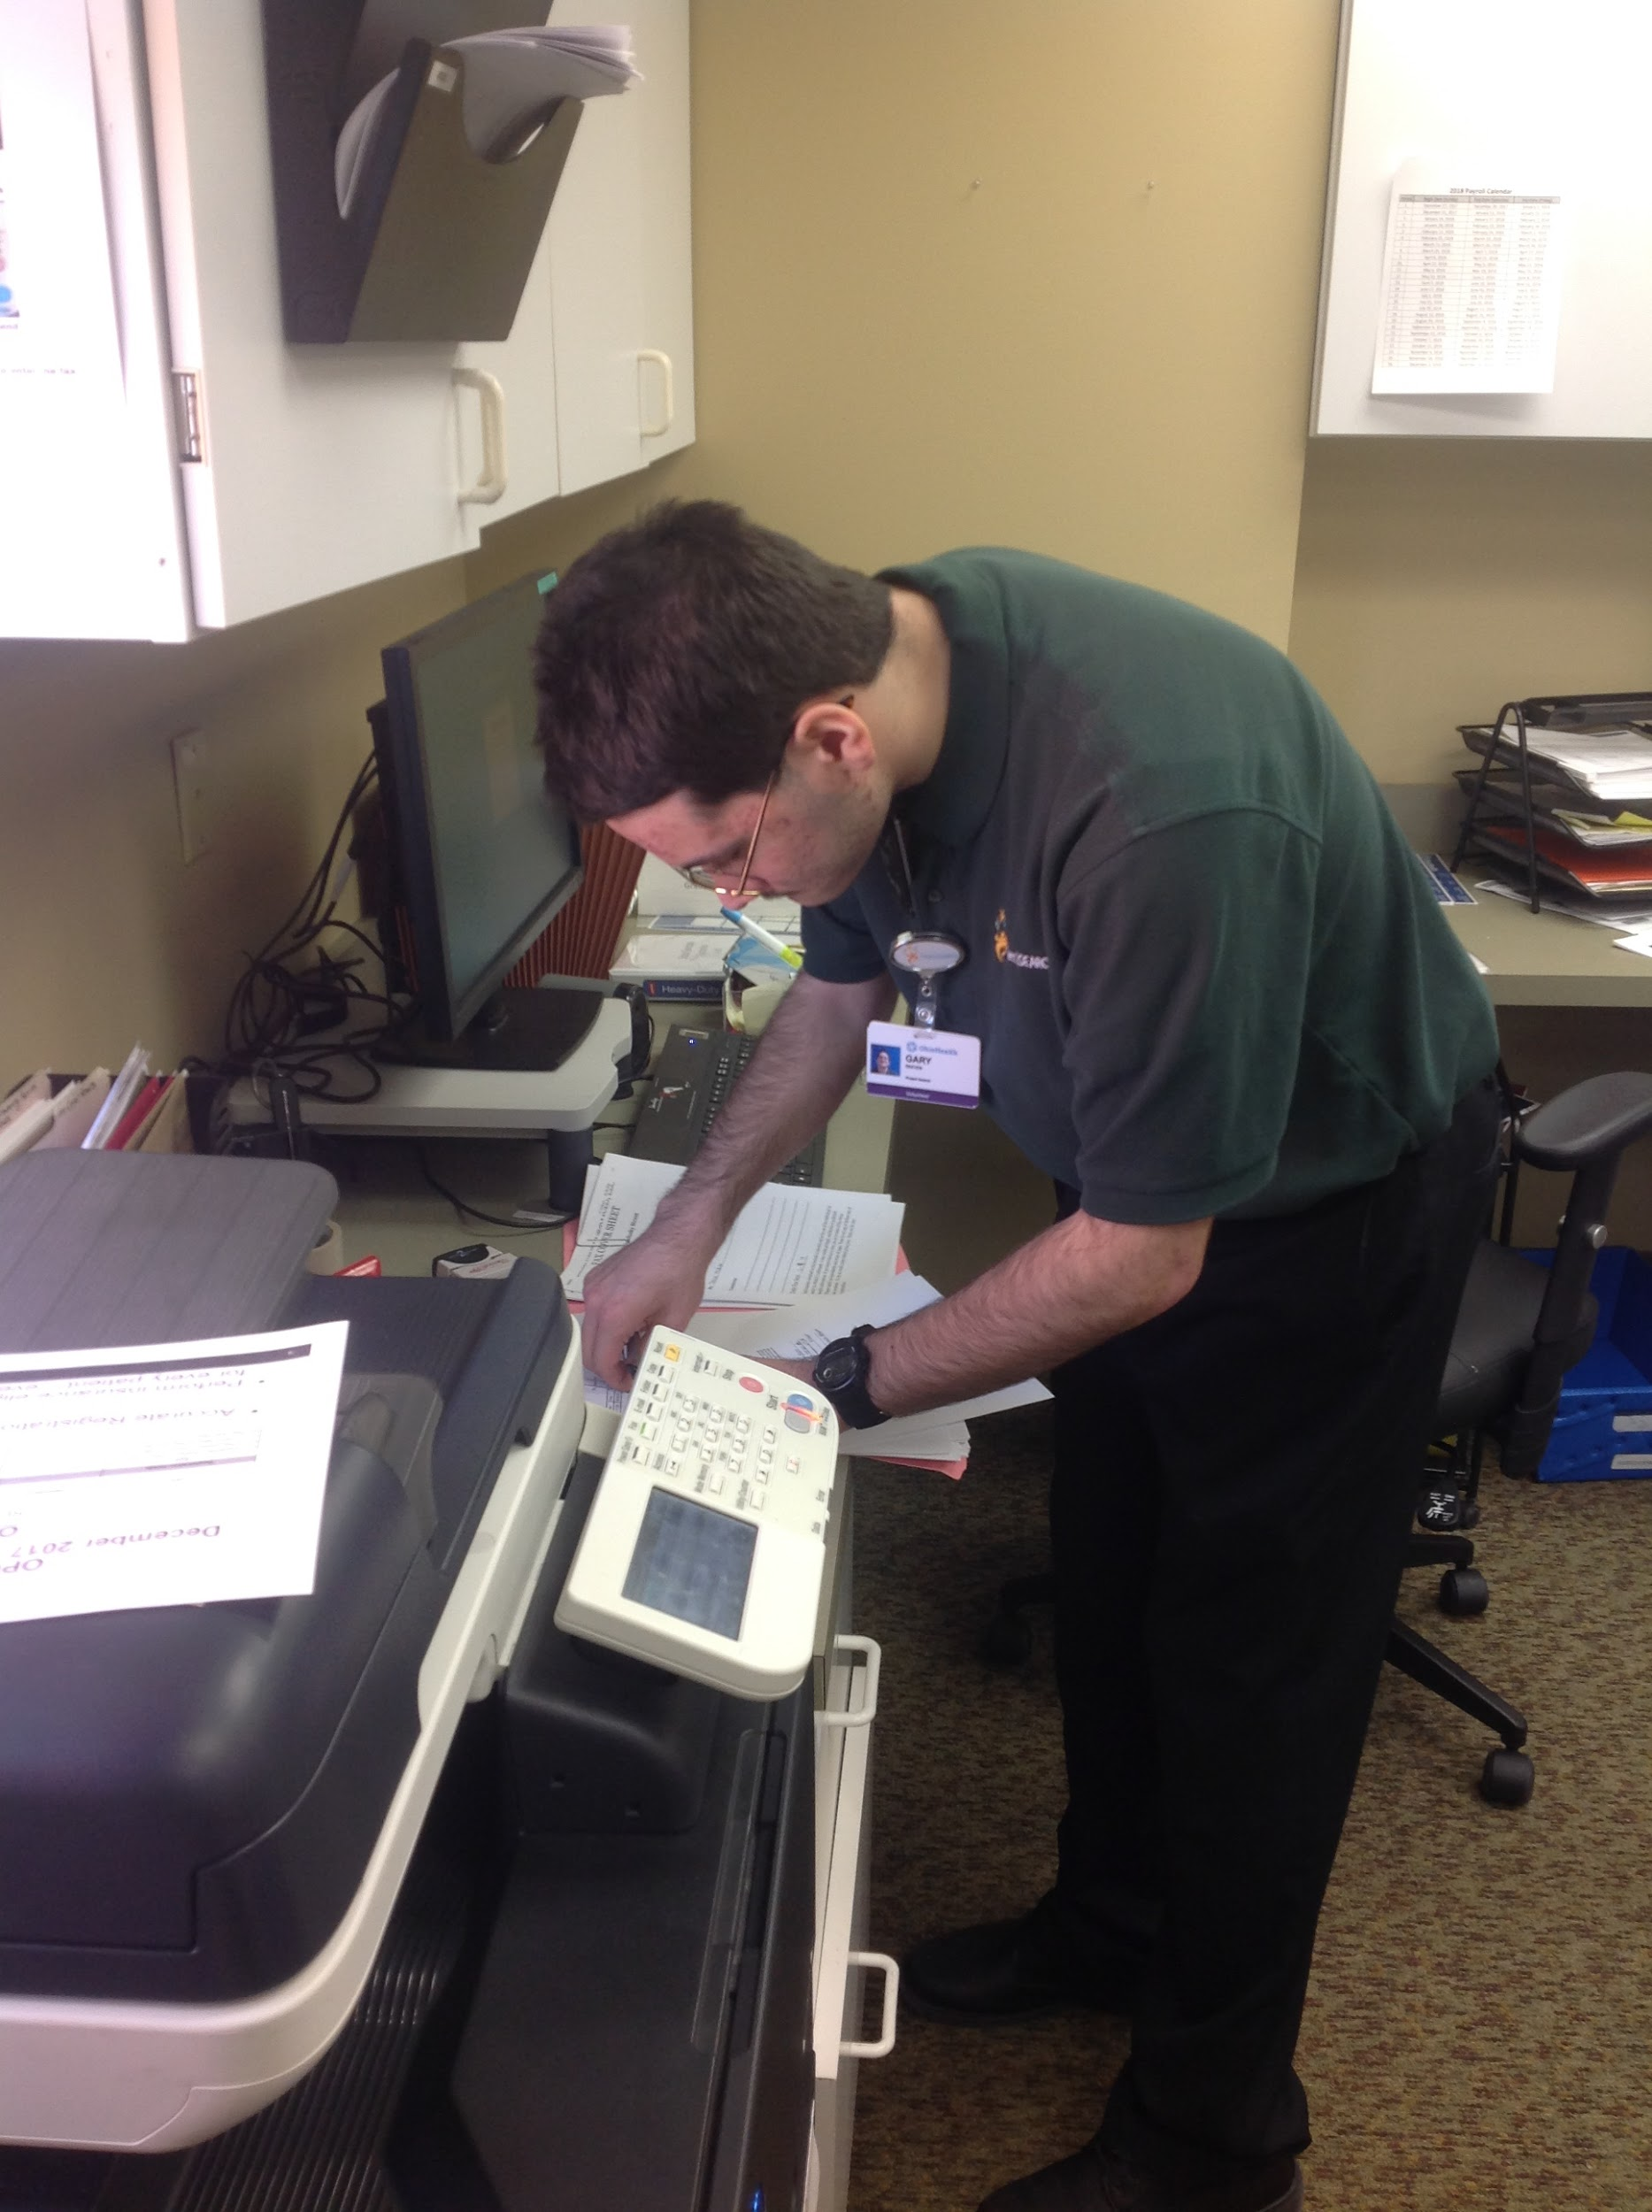
Internship rotation: HealthWorks Office
Questions
Internship rotation: Laboratory

